Slide 1
NWL Community-based Specialist Palliative Care (18+) Review Programme Update for JHOSC 25 November 2021
Summary:
NW London has commenced a focused piece of work to improve the quality, equity and experience of community-based specialist palliative care and support residents and their family/ carers receive, as well as the sustainability of our services
Context and Scope
Programme Approach
Issues paper and engagement plans
Ask of this group:
For noting and providing feedback on approach
Continue working with us as we take next steps

Slide 2
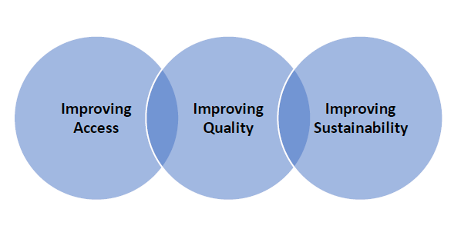
Context
OUR VISION:
NWL residents and their families/ carers have equal access to high quality community-based specialist palliative and end of life care and support, that is coordinated, and which from diagnosis through to bereavement reflects their individual needs.
This service improvement programme of work is following on from the 4 CCGS palliative care review work undertaken in 2019/20 across 4 of our CCG – Brent, West London, Central London and Hammersmith & Fulham.
We have some excellent community-based specialist palliative care services and committed partners and we want to build on this excellence and support our services to be as sustainable as possible
We do have variation in quality and level of service across NW London and this cannot continue – this will drive our approach.
We are committed to transparent and meaningful engagement with public, patients, families, carers and other stakeholders.
There are some immediate challenges on workforce and sustainable funding (given impact on the charitable sector during the pandemic) that we need to address at pace
Our priorities for this programme of work are
in line with the NHS triple aim:

Slide 3
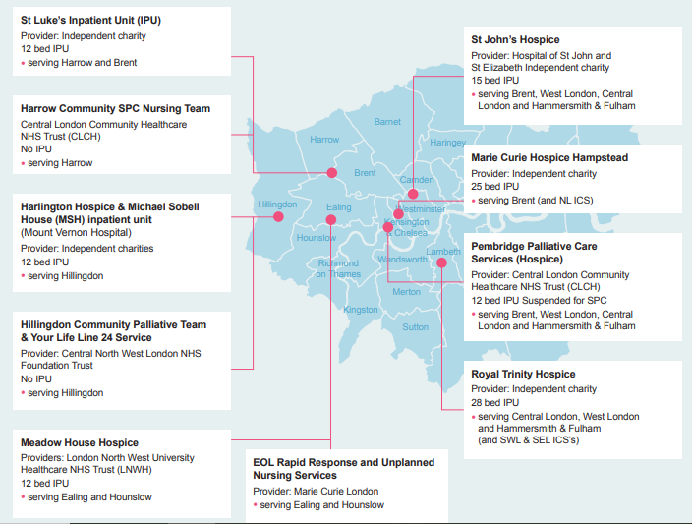
NW London’s adult community-based specialist palliative care (SPC) provision

Slide 4
Scope - What will this cover
It will focus on community-based specialist palliative services for adults (18 years +) across all of NW London, as this is the part of the end of life pathway that is most fragile at this time.
The work will not be reviewing children’s palliative and end of life care services, hospital based specialist palliative care and universal palliative care services such as community/district nursing and primary care.
We will however be working hard to make sure that our work links closely and integrates with hospital specialist palliative care and to all other generalist palliative and end of life care services in North West London.
We will also be working very closely with other NWL ICS improvement programmes of work underway i.e. Enhanced health in care homes (EHCH) programme, Community District Nursing Review, Acute Discharge hubs; Cancer

Slide 5
Why things need to change?
Too many people are admitted unnecessarily to hospital in their last year and last 3 months of life.
For 2020/21 - 49% of our residents are dying in hospital, 5% are dying in hospice, 14% in care homes and only 28% are dying at home – this is despite nationally the majority of people saying they would prefer to die at home.
We have unwarranted variation in community-based specialist palliative care services (ie. 7 day working, access to 24/7 specialist advice, rapid response) and we have heard that they don’t reach enough of our residents and diverse communities.
Not enough of our residents are identified early as being at end of life and offered opportunity to undertake advance care planning conversations, that are then recorded on Co-ordinate My Care (CMC – the agreed London tool at present).
Not all of the system have access to and are using CMC as much as they could be.
Notes:
https://www.longtermplan.nhs.uk/

Slide 6
How we plan to do this - our objectives:
Our aim through this work is to collaboratively develop a new integrated model of care, single service specification for our services and a consistent approach to population health needs and person centred outcome measures.
We plan to have wide reaching, robust and transparent communication and engagement with public and patients, including community, voluntary and faith groups.
Publication of Issues Paper and other supporting documentation designed to facilitate discussions and support innovative thinking.
Collaboratively design more responsive, sustainable and resilient services with a wider reach.
Achieve consistency and equity in access to services across NW London and level up to good practice where possible.
Facilitate better co-ordination of care, improve communication and integration with other services across community and acute care settings.
Collaborative working and pathway development with other ICS programme including Cancer, Enhanced health in care homes, Continuing Health Care, community nursing and acute discharge improvement work.
Work in partnership with health, social care and the voluntary, community and faith sectors.
Explore development of compassionate communities with more integrated/ partnership working with Voluntary Community Sector.
We will develop a consistent approach to person centred outcome measures, population health needs assessment, benchmarking and monitoring.
We are working closely with our social care partners to utilise digital technology to support the development of shared care records for care homes.

Slide 7
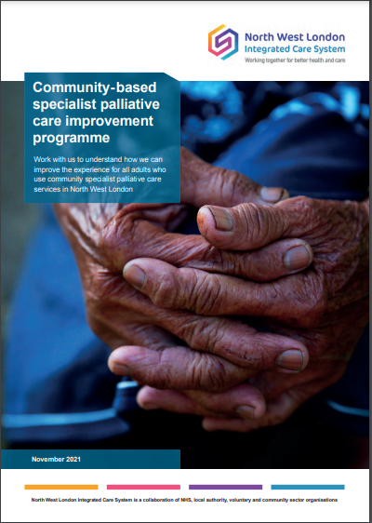
Issues paper and survey published
The programme was launched last week 18 Nov 2021 with the publication of an issues paper and a survey on the NWL ICS website
Find out more about how to get involved here: https://www.nwlondonics.nhs.uk/get-involved/cspc/how-get-involved

Slide 8
Issues paper
In development - our focus at this stage is what quality, safety, equity and excellent patient experience looks like. From this we will develop new models of care and what good patient outcomes look like. It is only after that is agreed will we look at what services we need to deliver this.
We have simply set out the eight broad themes we are looking at and would like to the public to feedback on :
1. Learning from previous service improvement reviews and engagement
2. National policy – making sure we align
3. Changing needs of patients and population growth
4. Health inequalities – how these act as a barrier to people receiving community-based specialist palliative care
5. Improving the quality of care, and patient and family and carer experience – we have variation across NWL
6. Fragmentation and the need for more joined up services - people sometimes find services these hard to access, particularly across our more diverse communities, and services do not work as well together as they could be
7. The workforce challenge - we are having difficulty recruiting and retaining workforce
8. The financial challenge - the increasing financial challenge the NHS is operating under and what it means for community-based specialist palliative care provision
From this we will develop a consistent set of questions that will allow us to obtain a mixture of qualitative and quantitative feedback.
Publication of this Issues Paper will officially launch the programme of work

Slide 9
Timeline: August 2021 – August 2022
Issues paper Pre-engagement (virtual)
August – October 2021
Pre-engagement with key stakeholders – internal and external
Issues paper Engagement report February 2022 Writing up of report based on feedback from Issues paper and engagement exercises
Development of new model of care
April – July 2022
In Partnership with patients, clinicians and stakeholders develop model of care and services needed to deliver
Aug- Oct 21
Nov 21 – Feb 22
Feb 22
Mar 22
Apr-Jun 22
Aug-Oct 22
Publish Issues Paper Engagement Report
March 2022 Publication of outcome report and next steps- testing outcomes with public and stakeholders (feedback loop)
Issues paper Engagement Period (virtual)
Early November to early February 2022
- Patient engagement starts with publication of Issues Paper
- 3 or 4 local meetings
- 1 or 2 discussion events across the system - to go into more of the detail
- Separate meetings with faith groups and targeted groups who aren’t getting access – homeless, LGBTQ+
Public consultation
August – October 2022
Public consultation on changes to services if needed

Slide 10
Diagram of overall comms & engagement strategy up until March 2022
6 neighbourhood based conversations- focused on areas of greatest inequality)
Launch of issues paper
Series of facilitated engagement workshops based on neighbourhood / community / faith-based conversations
Writing up of engagement report
Publication of report and testing have we heard right
Purdah and next steps
Can run in parallel to each other
1 Inter-faith conversation and 4 faith specific sessions
Can run in parallel to each other
5 further sessions focused on key protected groups (ethnicity, disability and sexual orientation, carers)
Can run in parallel to each other
virtual options session
10

Slide 11
Proposed programme stakeholder workshops and early workstreams
Clinical model groups, tasks and sequence flow
WORKSHOP 1: Gap analysis using Ambitions Self Assessment tool
WORKSHOP 2: Gap analysis using Ambitions Self Assessment tool & Outcomes we want to achieve
Services Demand mapped per 200k population
activity data across acute, community and hospice
WORKSHOP 3: Test Model of Care and Options
New Service Spec & Model of Care – configuration, workforce model
Service Change Options development
Can run in parallel to each other
Services Capacity
what services and staff we currently have against demand
8x ‘place based’ workshops re local integration
Note: Finance working group tasks will be dependent on the sequencing above ie. We can’t start costing up of new service spec and model until it is developed
Main Large stakeholder group: 40 – 50ppl
multiple patients from across all of NWL
wide range of clinical and operational leads (hospice and community services)
Primary care
LAS, NHS111, Care homes, Voluntary sector
Small sub working group –cross cut of main stakeholder group
1 or 2 patient reps / none
8 to 10 ppl max
Stakeholder
Key:
Medium sized working group – cross cut of main stakeholder group
2 – 4 patient reps
10 – 15ppl

